Slide 1
24MAT120
S2 P/M

Slide 2
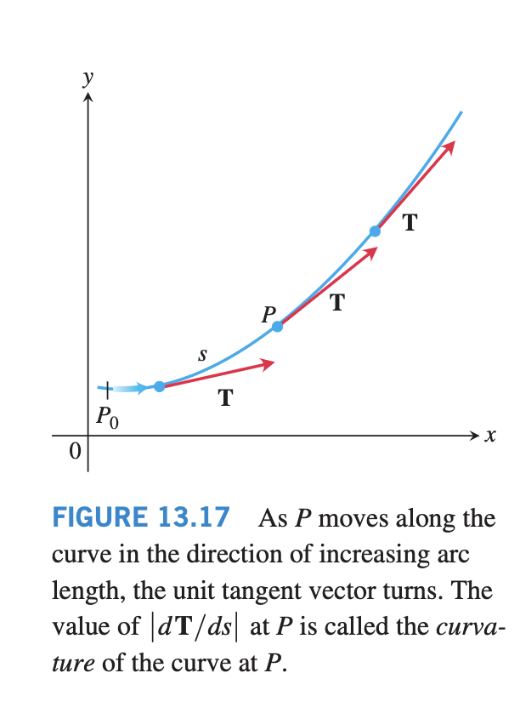

Slide 3

Curvature = rate of change of the direction of motion with respect to distance travelled,
not time.

Slide 4
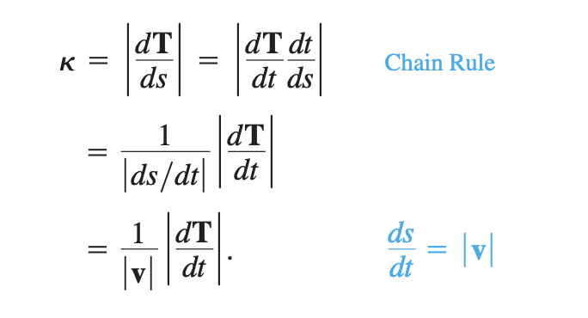

Slide 5


Slide 6
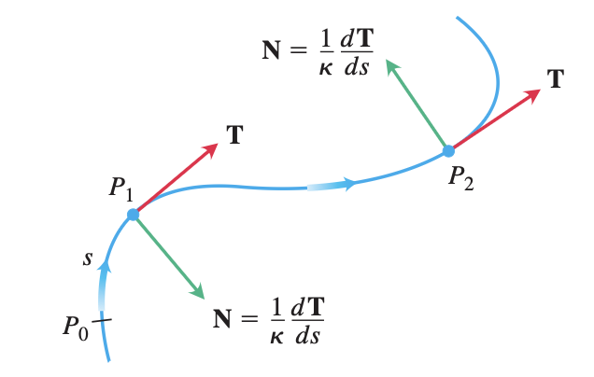
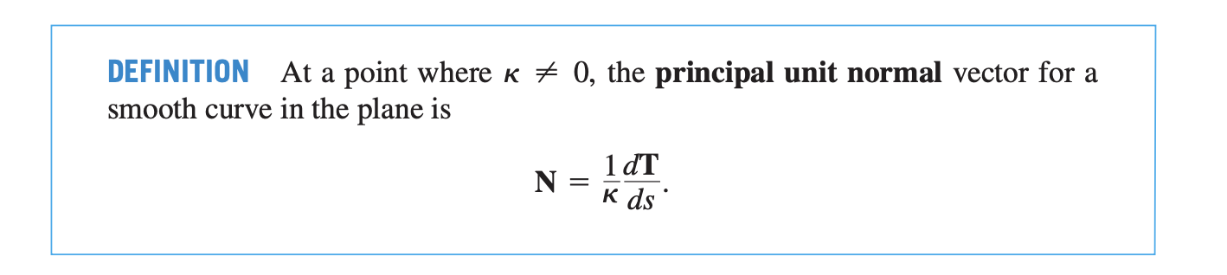

Slide 7


